Slide 1
DS1001
SOCIOLOGY OF DESIGN
GROUP PROJECT -1
COLLAGE MAKING

Slide 2
TEAM MEMBERS
SUB GROUP-1
SUB GROUP-2
SUB GROUP-3​
​
EC23B1102
EC23B1061
EC23B1120
EC23B1135
EC23B1024
EC23B1127
EC23I2020
EC23I2010
EC23B1014
EC23B1011
EC23B1002
EC23B1031

Slide 3
FINAL COLLAGE

Slide 4



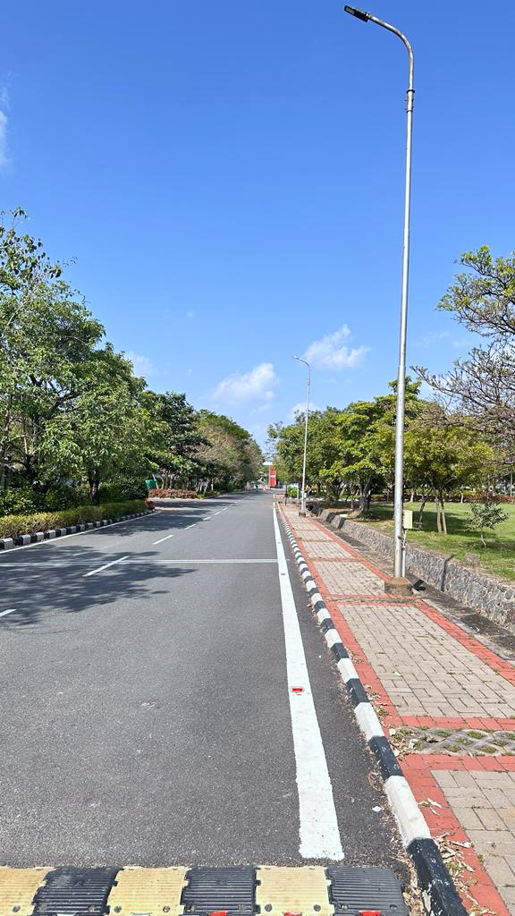

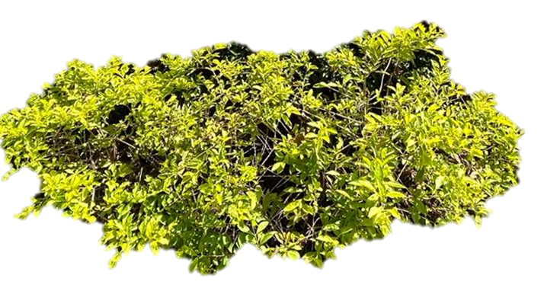

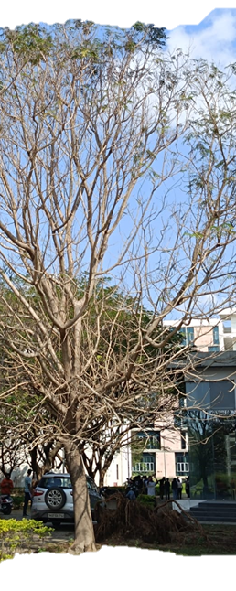


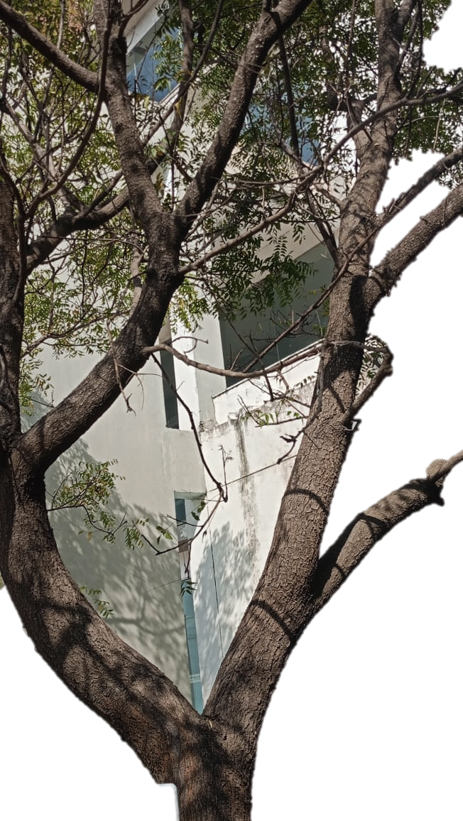
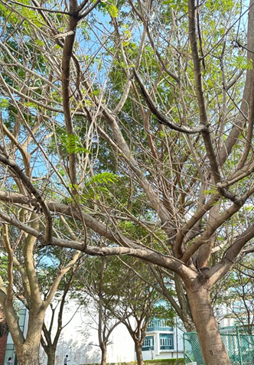
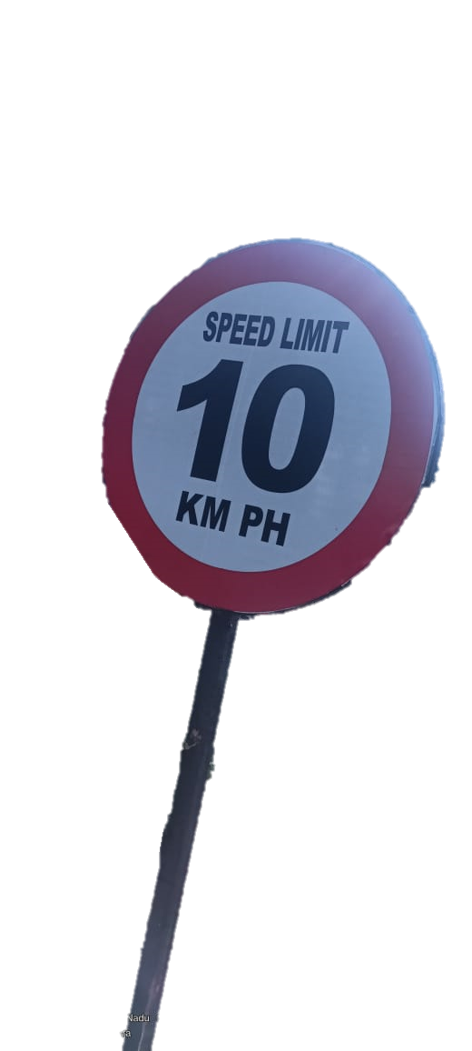

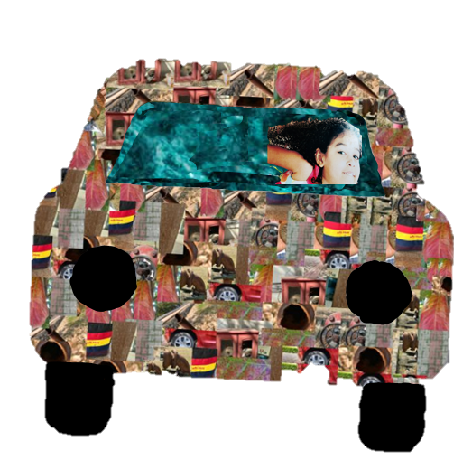
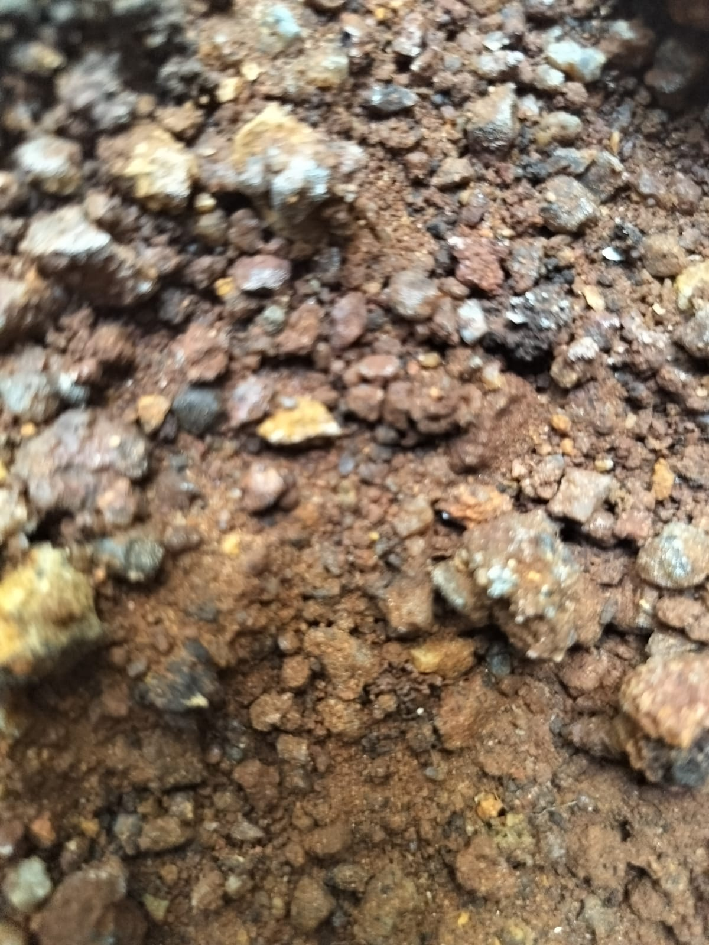

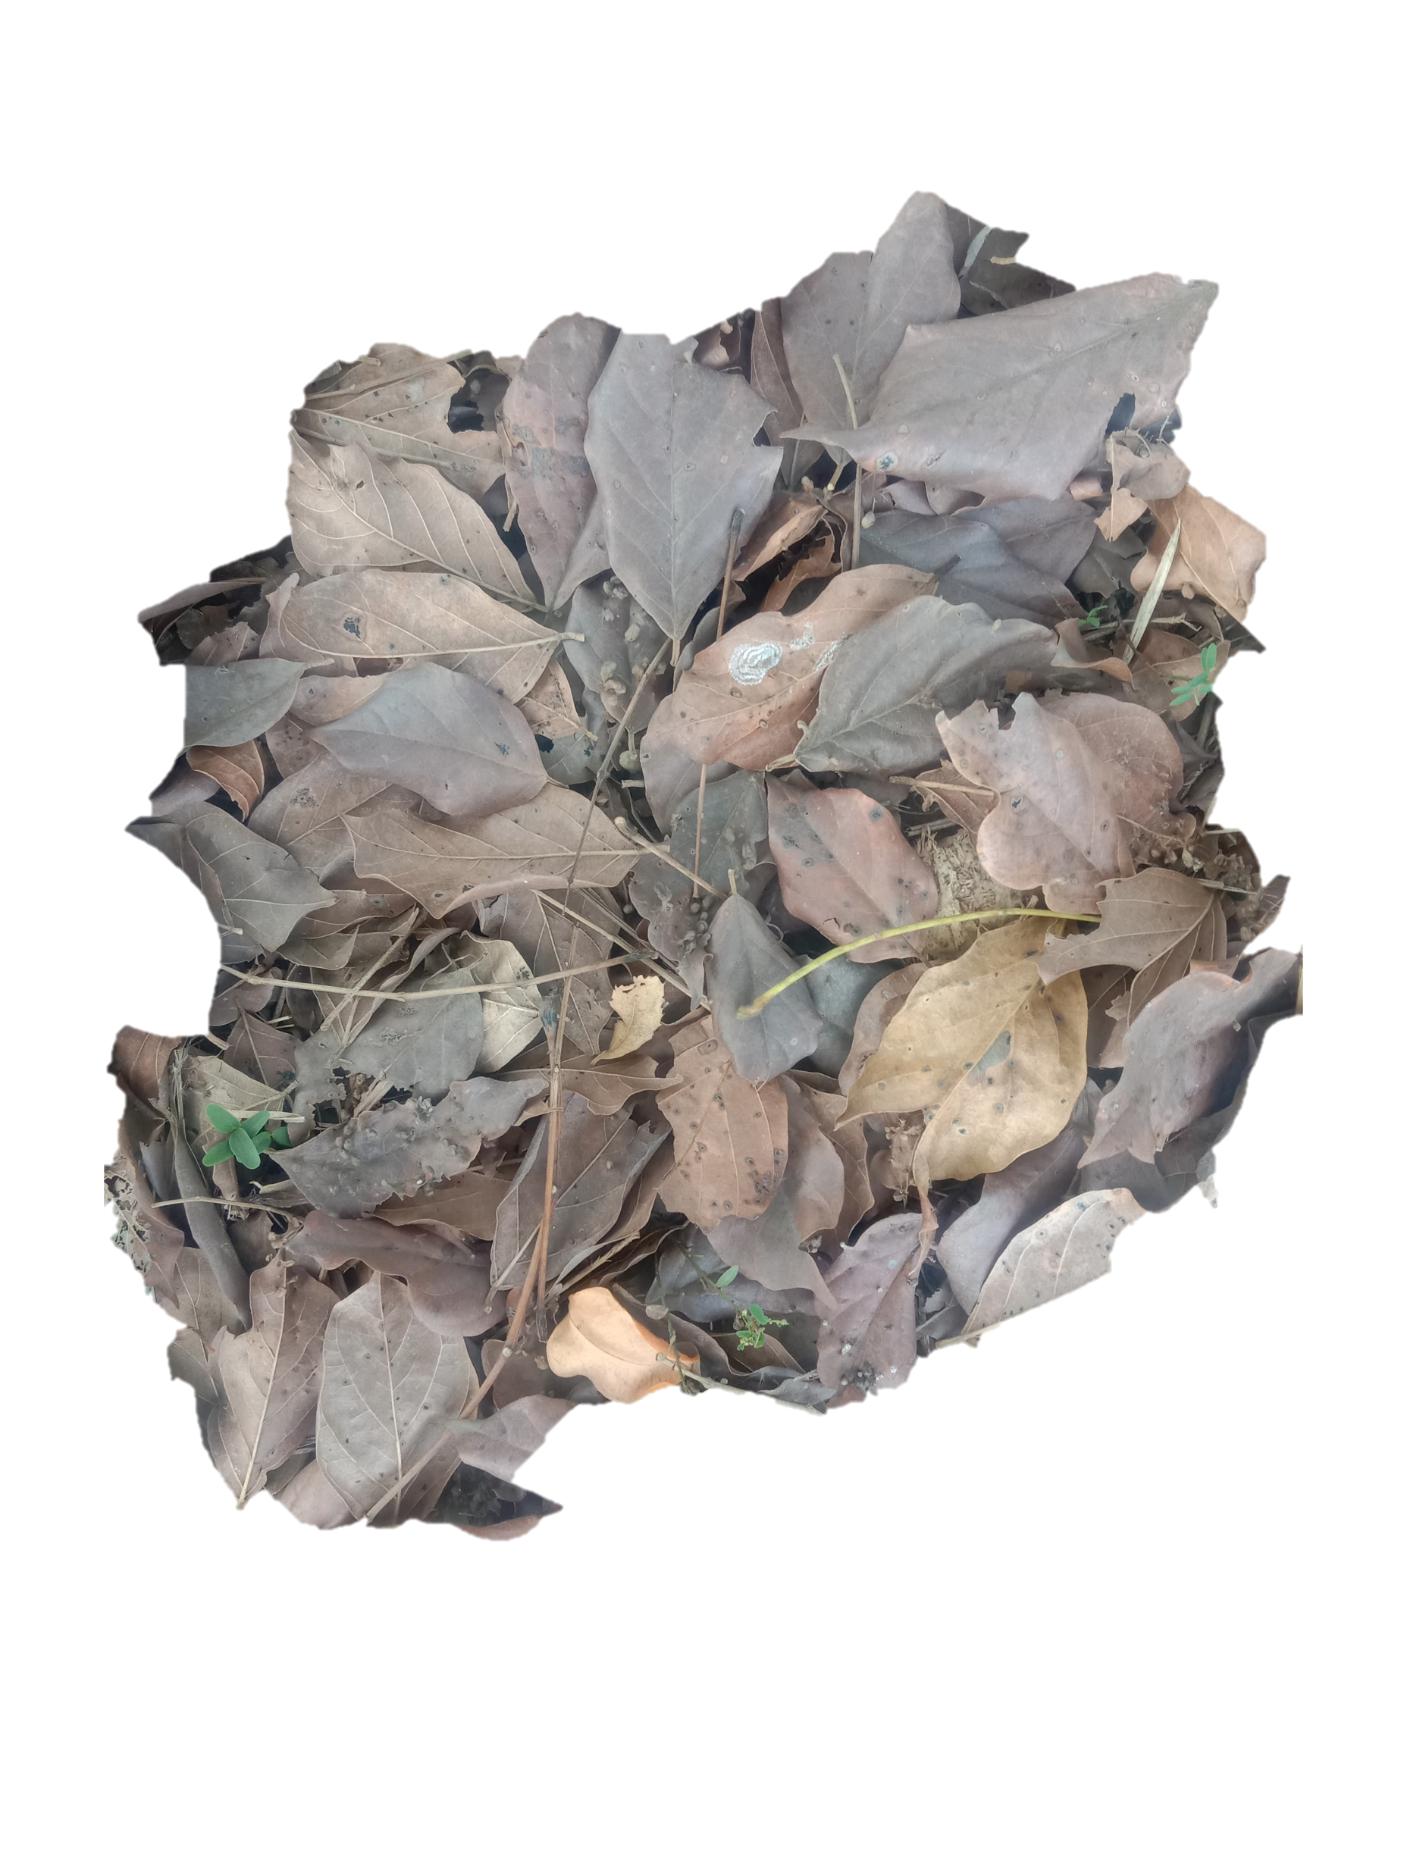

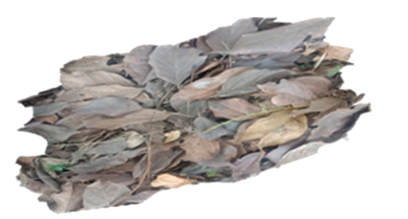
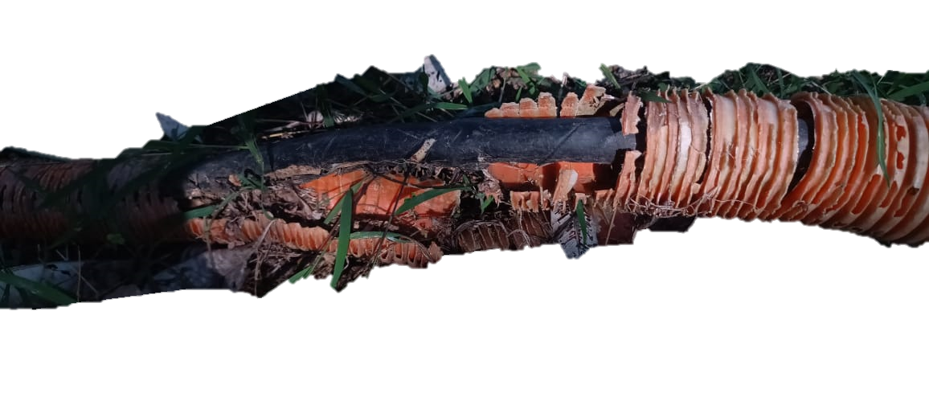

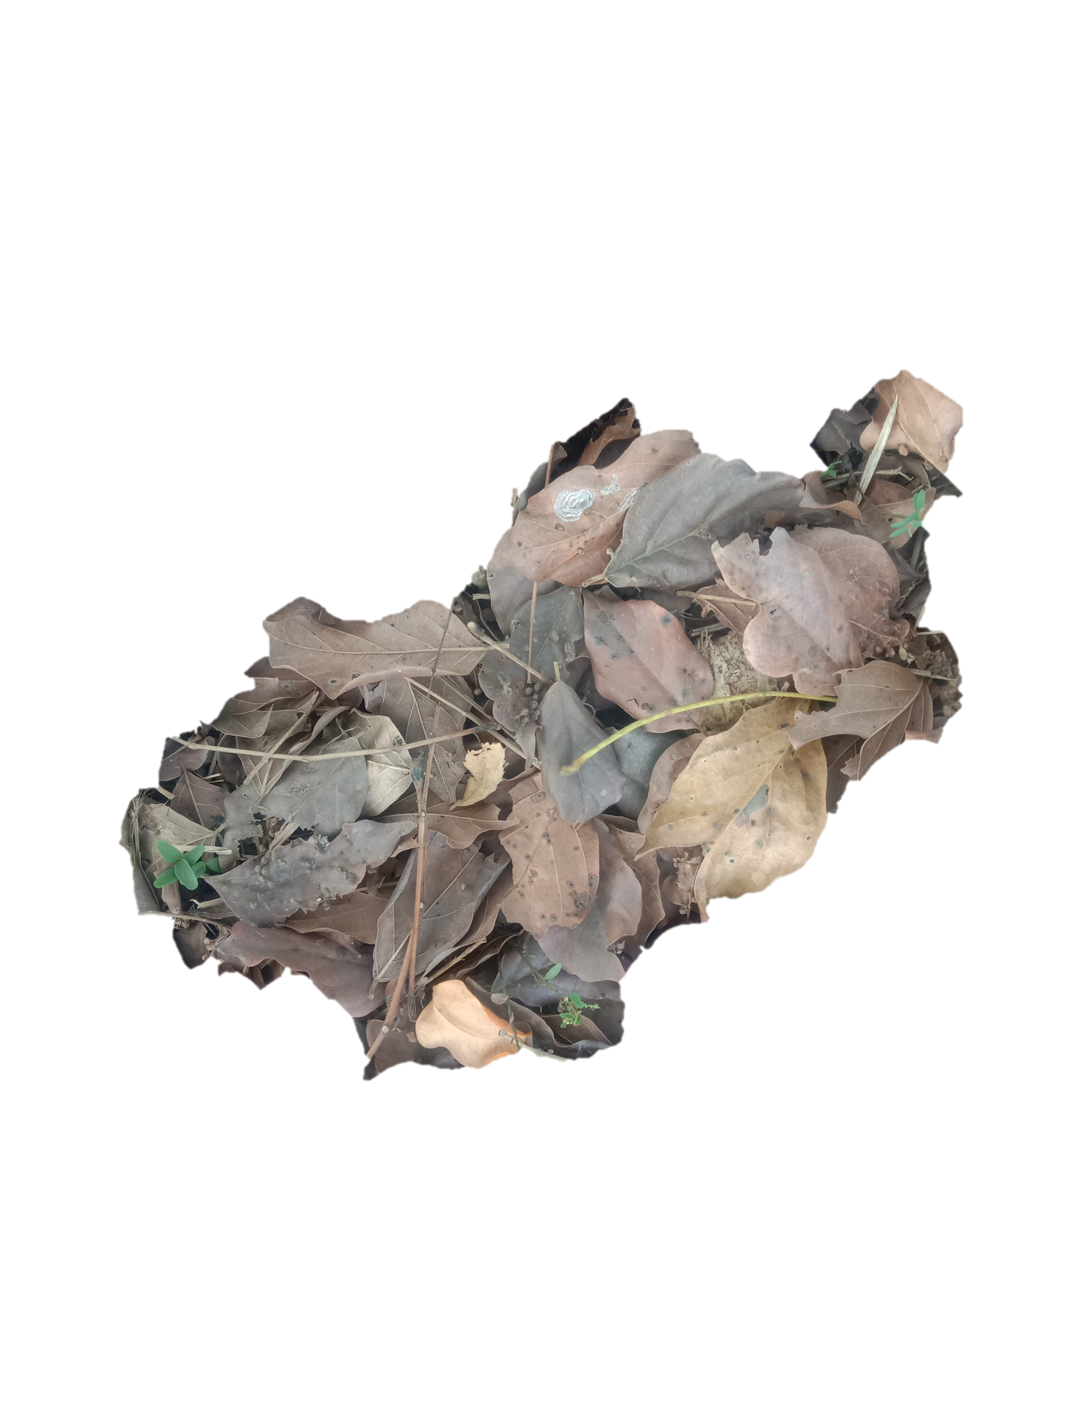
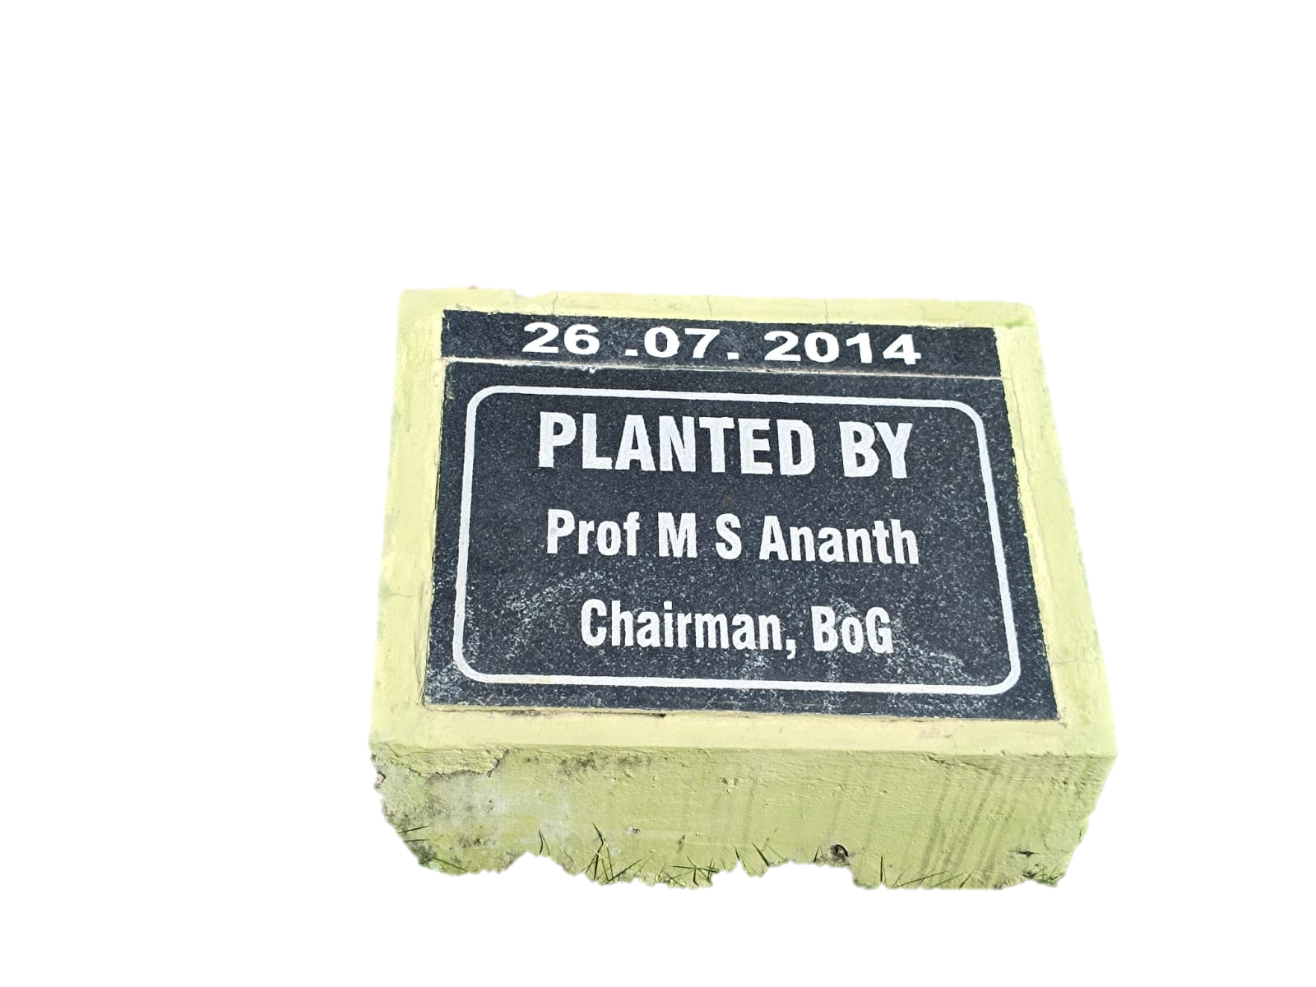
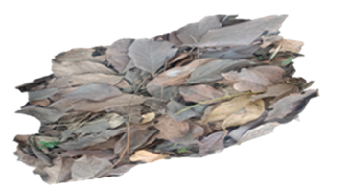
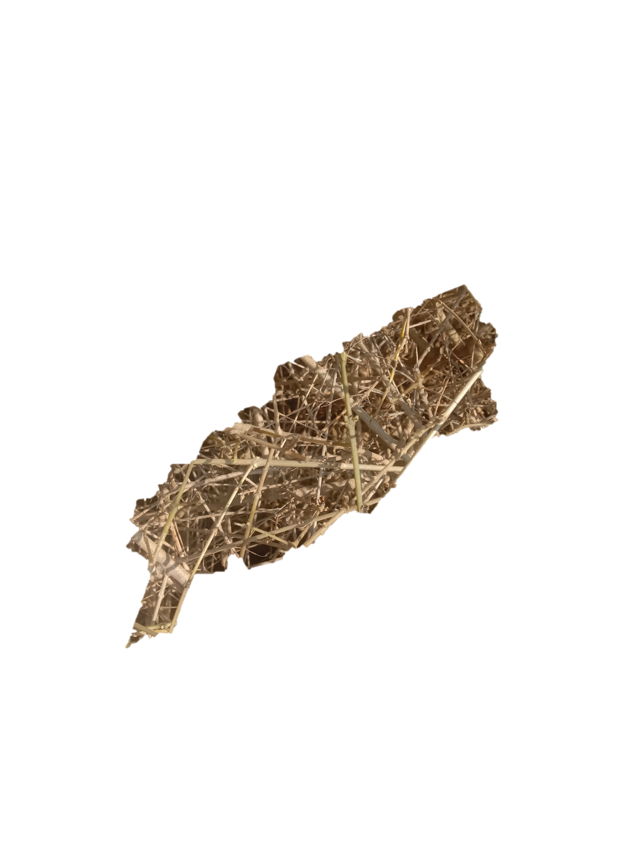


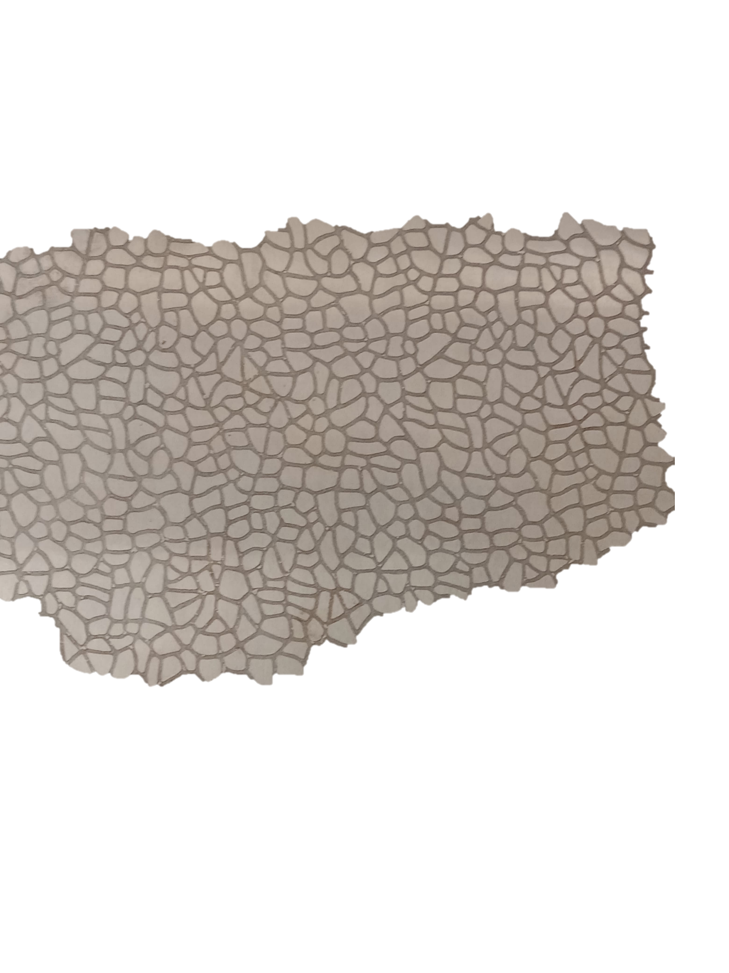

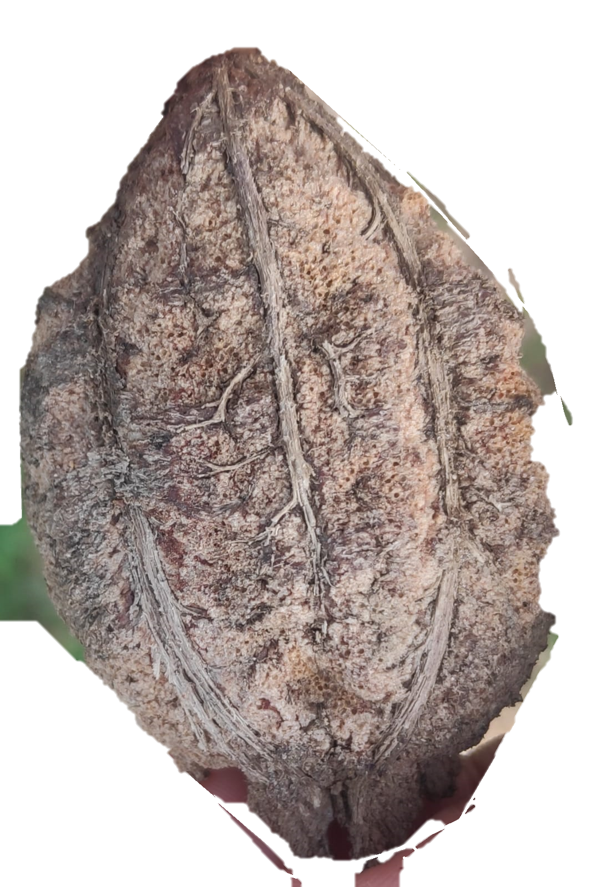


Slide 5




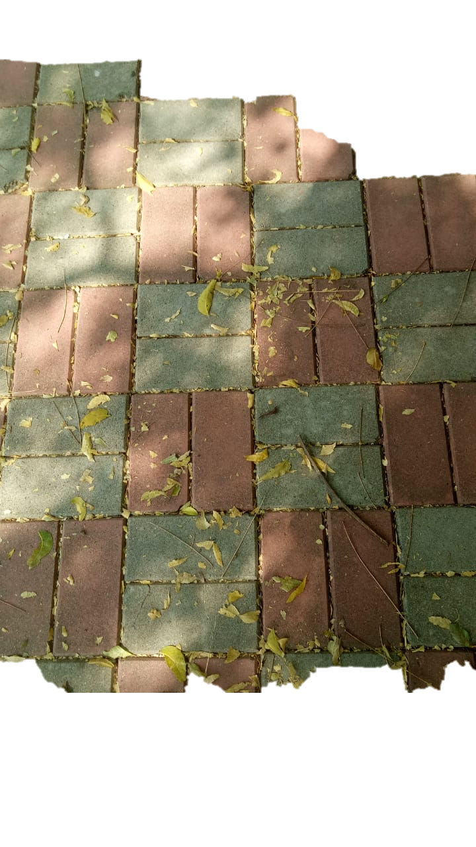

Slide 6
SUB GROUP
COLLAGES

Slide 8
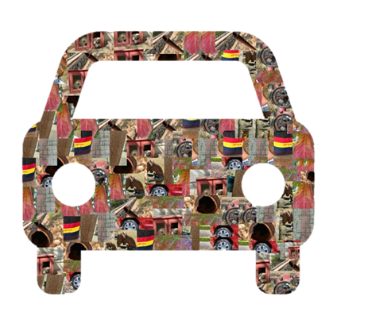
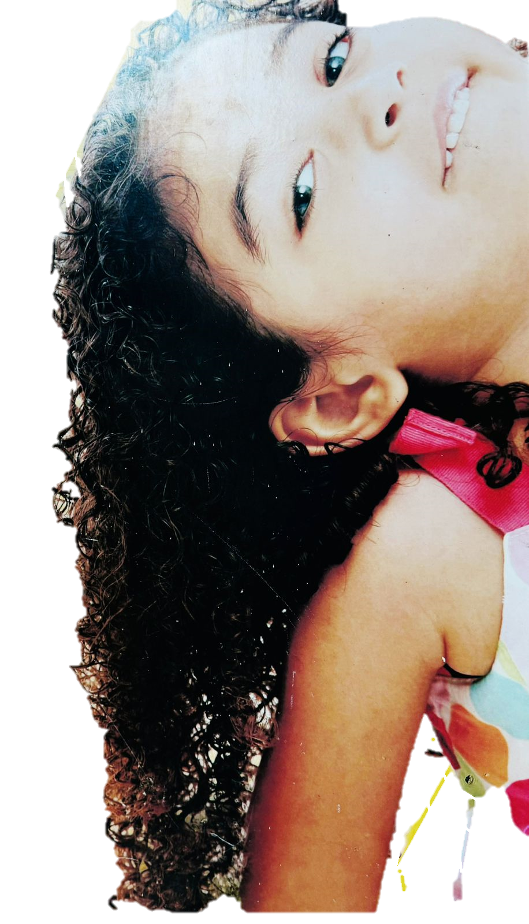

SUB GROUP-2
SUB GROUP-3

Slide 9
INDIVIDUAL
DATA
COLLECTIONS

Slide 10
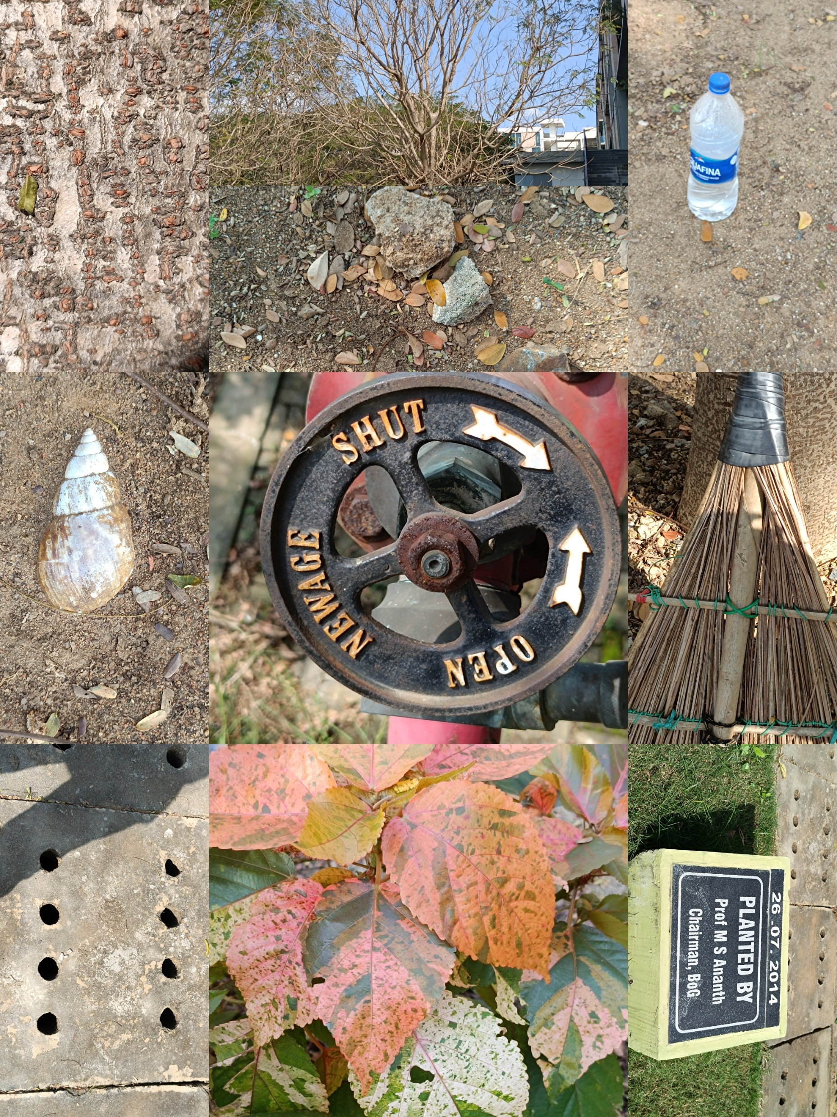
EC23B1102
MADHAMSHETTY
SATHVIKA

Slide 11
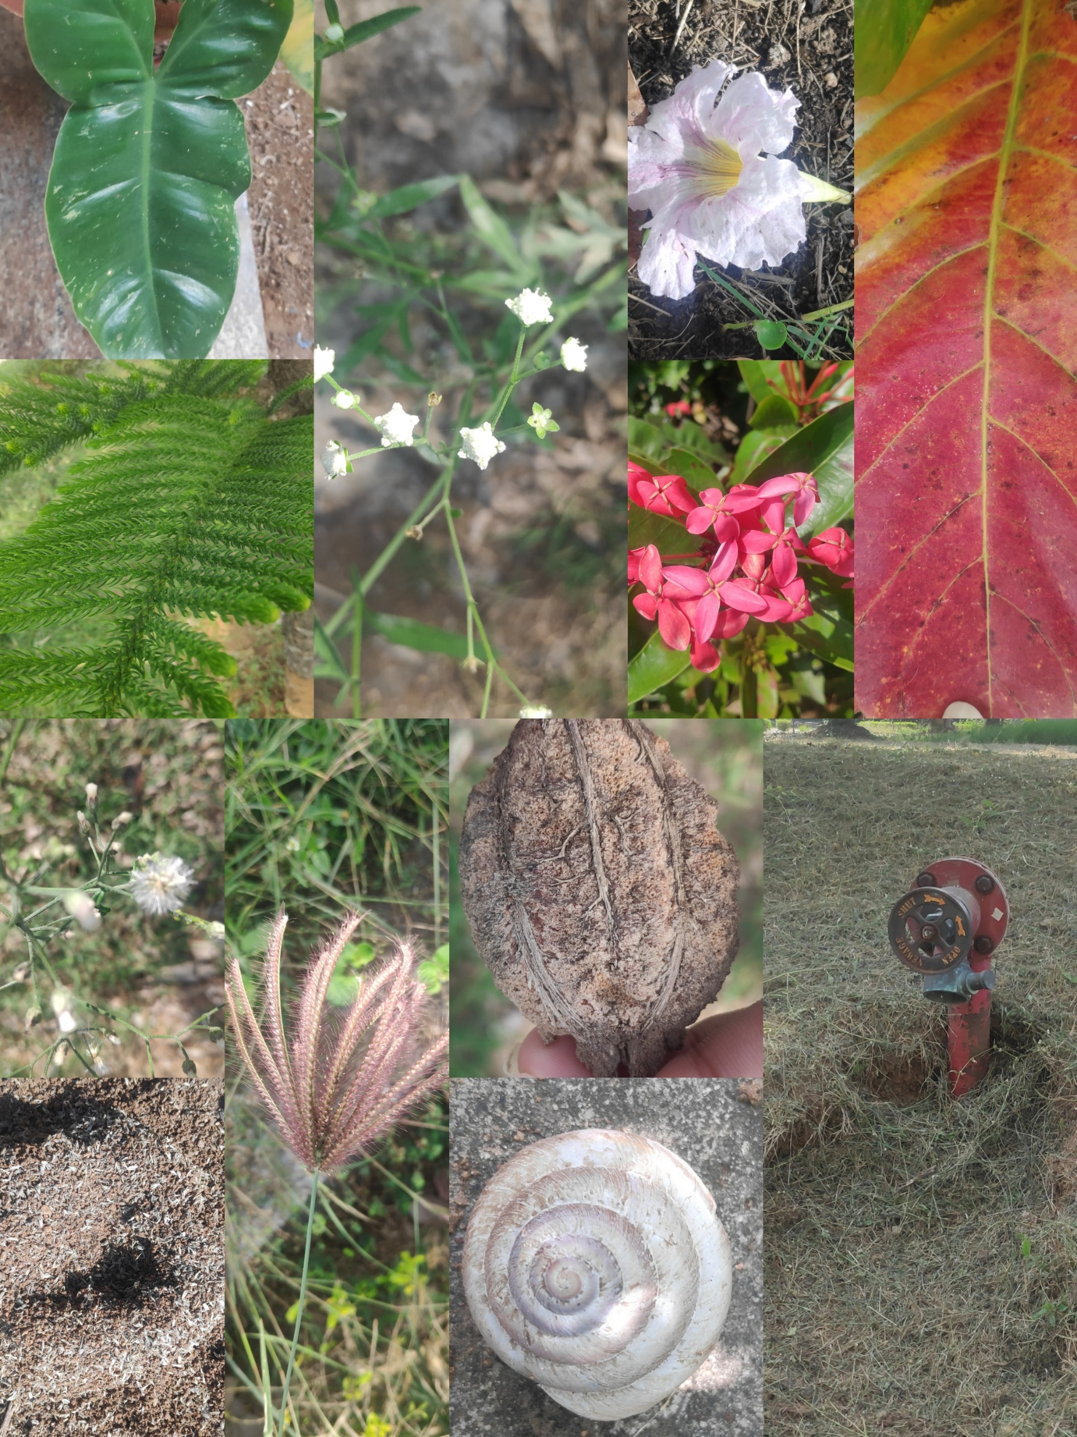
EC23B1061
CHALLA NAGA
BHAVISHYA

Slide 12
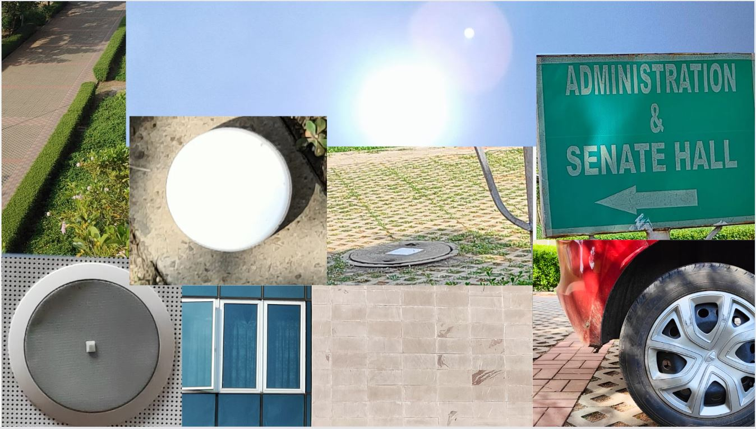
EC23B1024 BOINA DESHIK

Slide 13
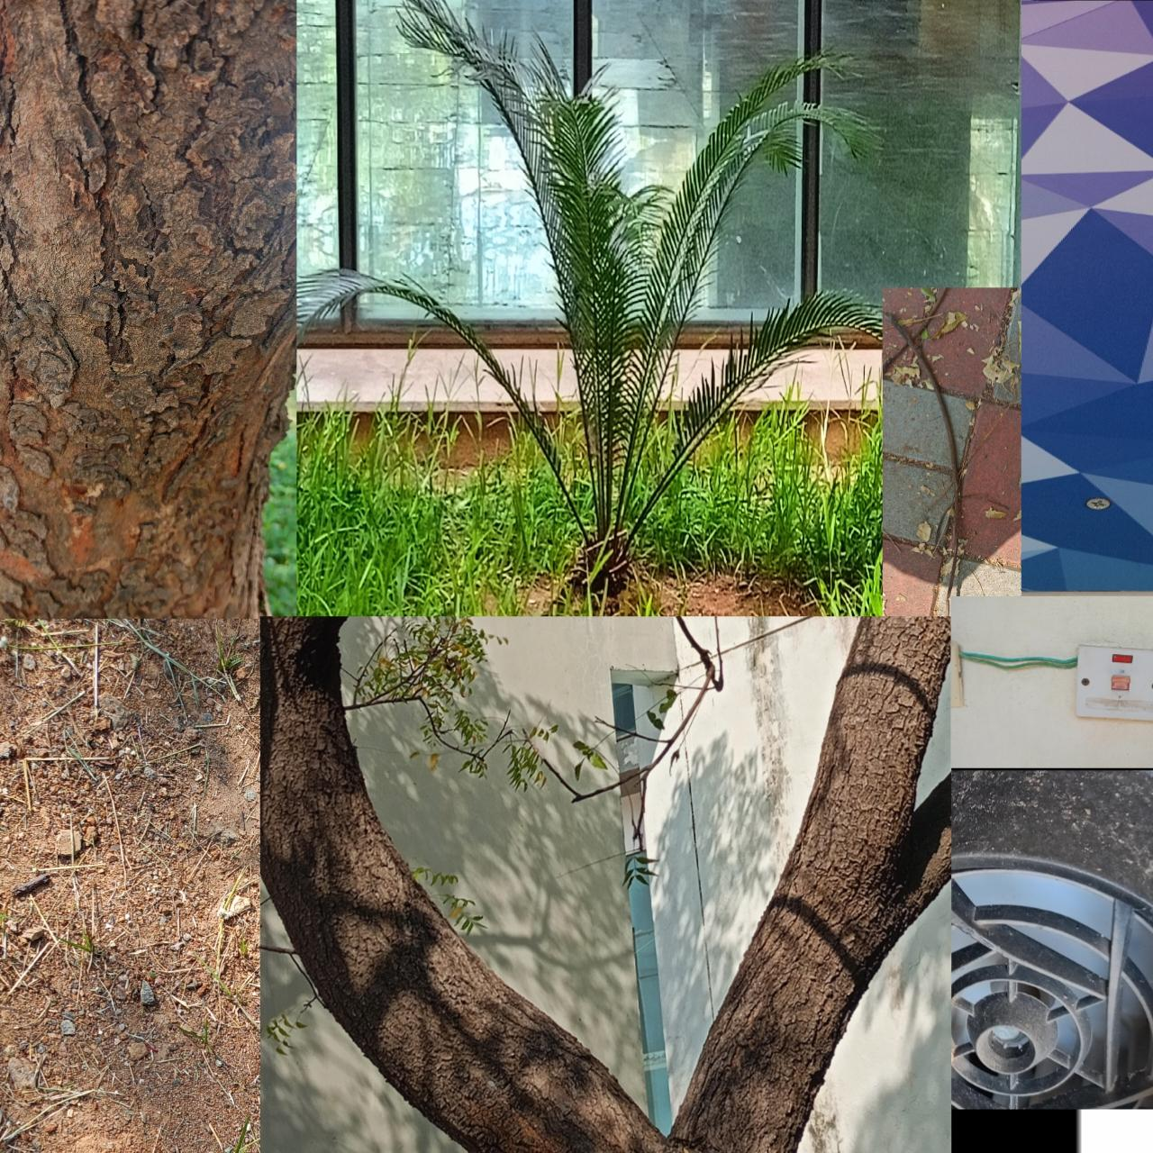
EC23B1002
G DEAVI ASRITHA

Slide 14
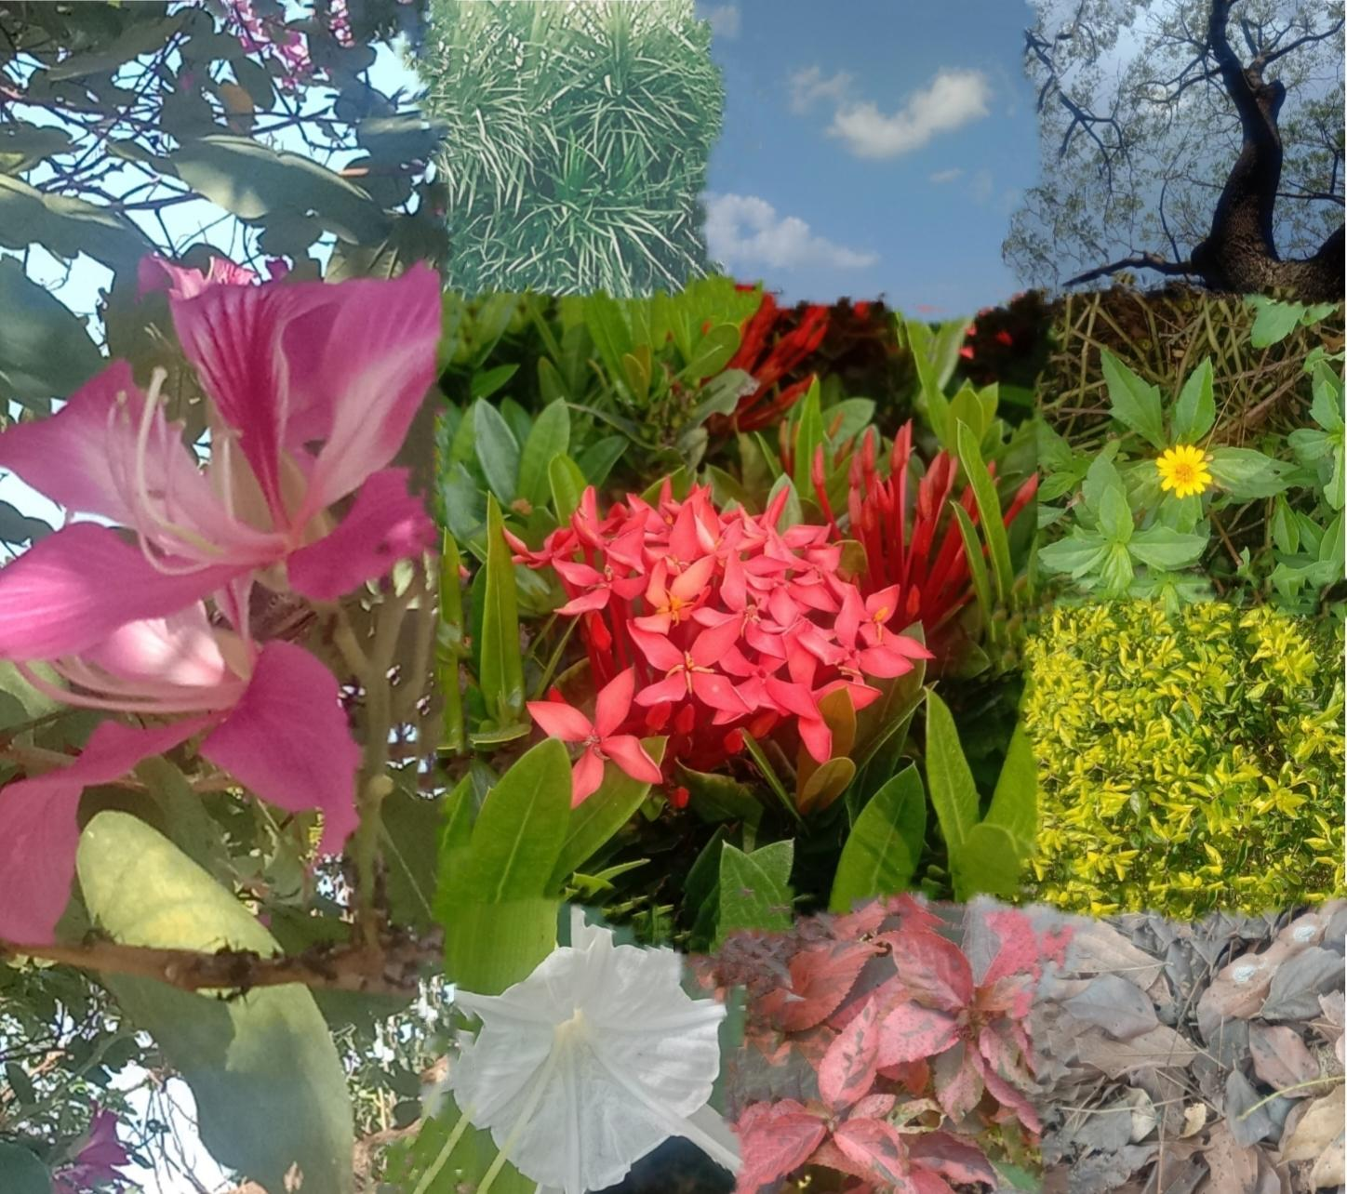
EC23B1135
ARULMOZHI

Slide 15
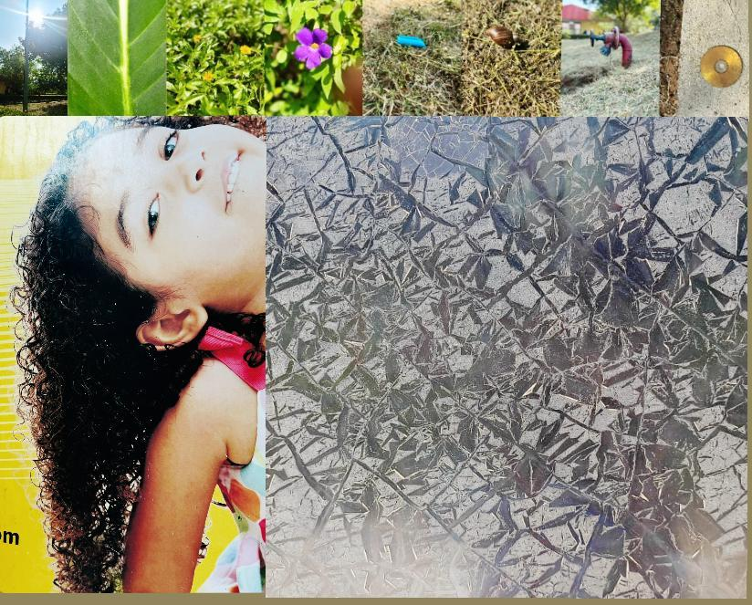
EC23B1014
CHALLA PALLAVI

Slide 16
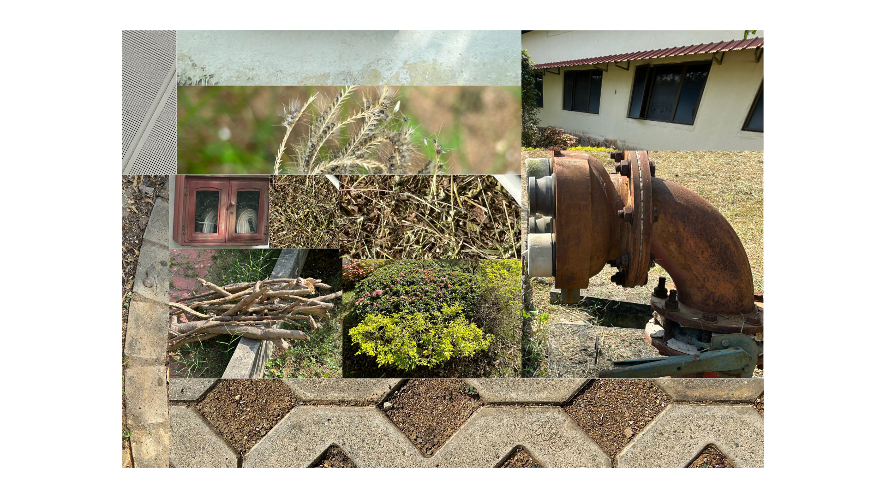
EC23B1011
NUKALA SUPRIYA

Slide 17
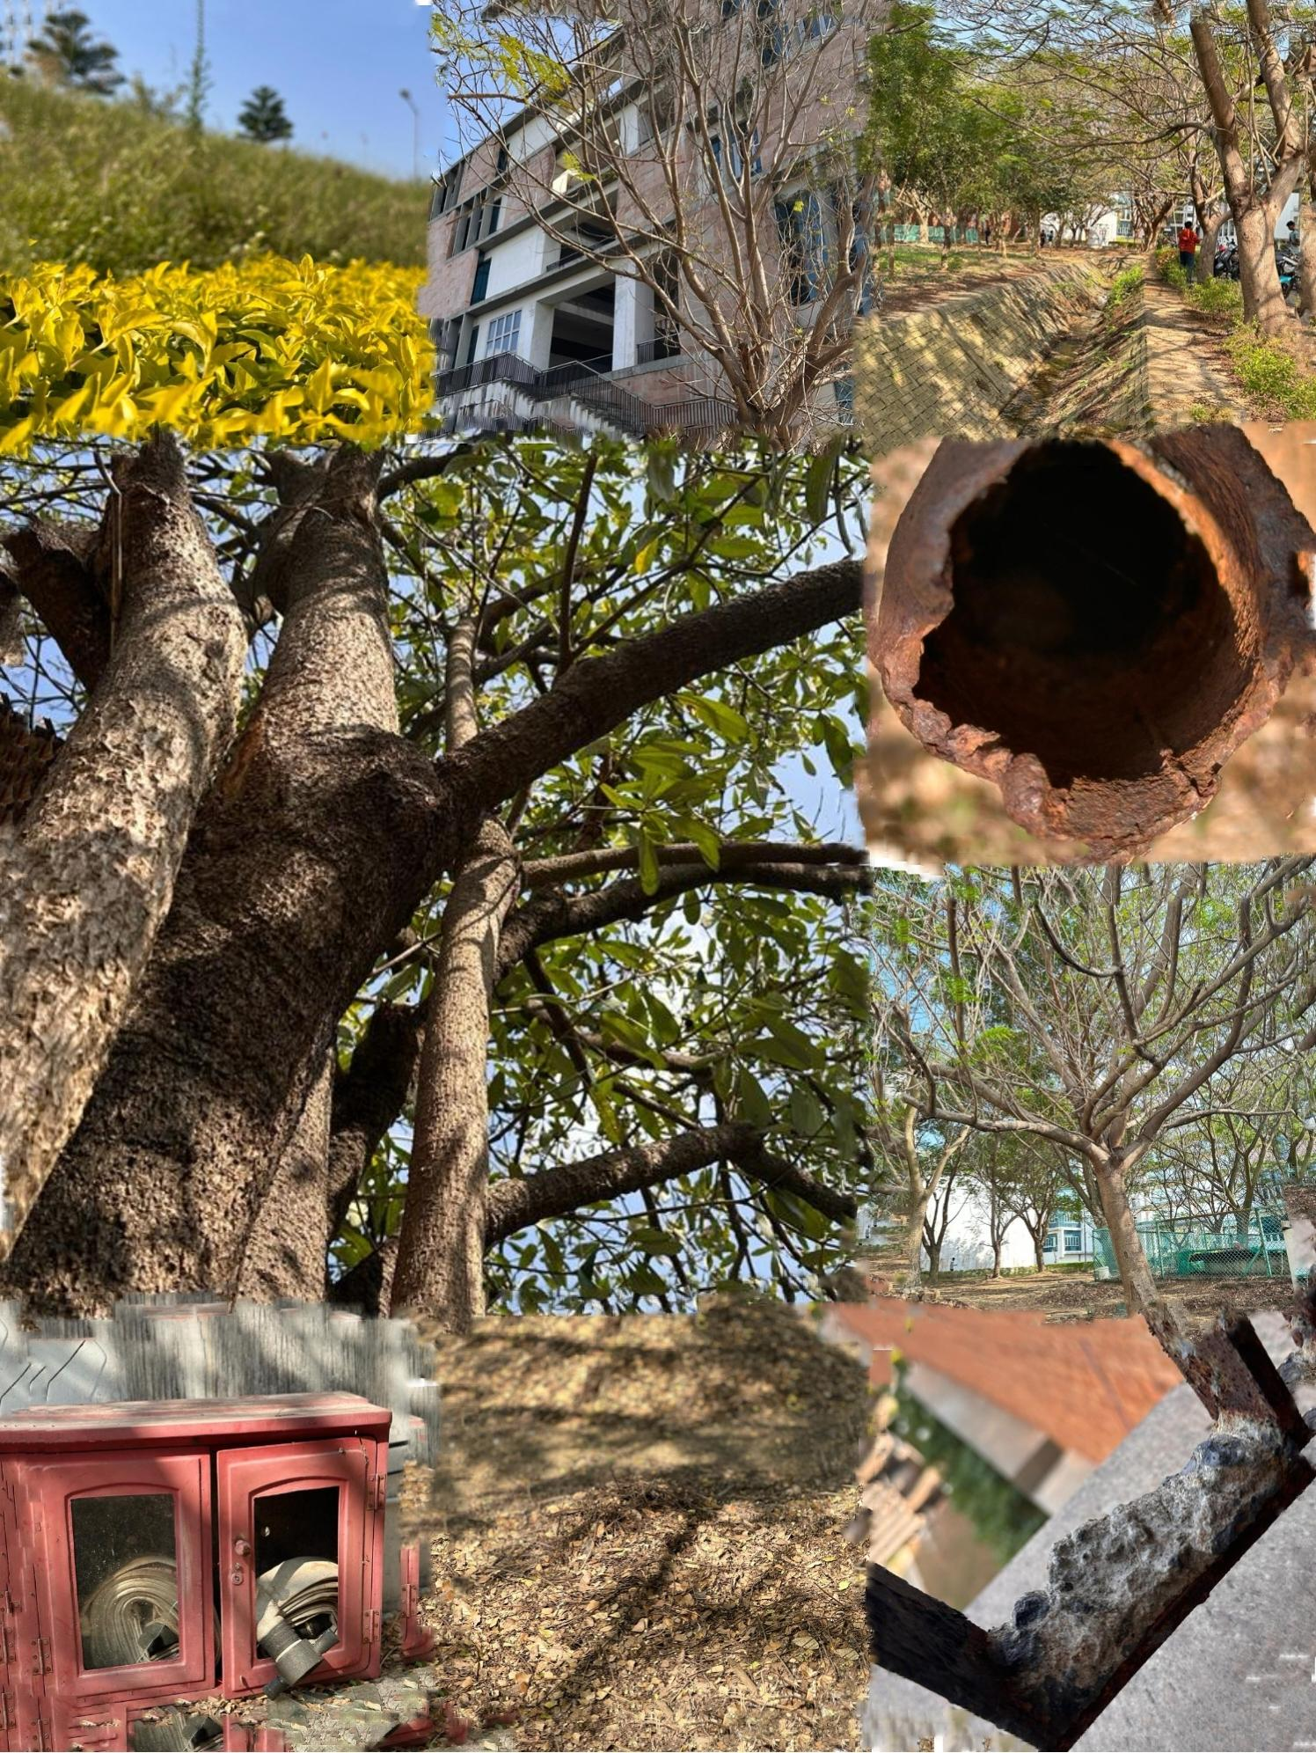
EC23I2020
M.AKRAM BAIG

Slide 18
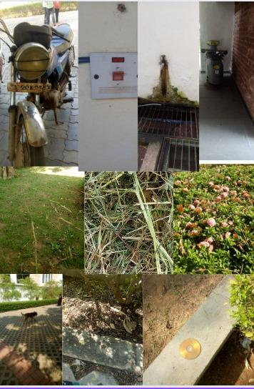
EC23B1031
S.AKSHAYA

Slide 19
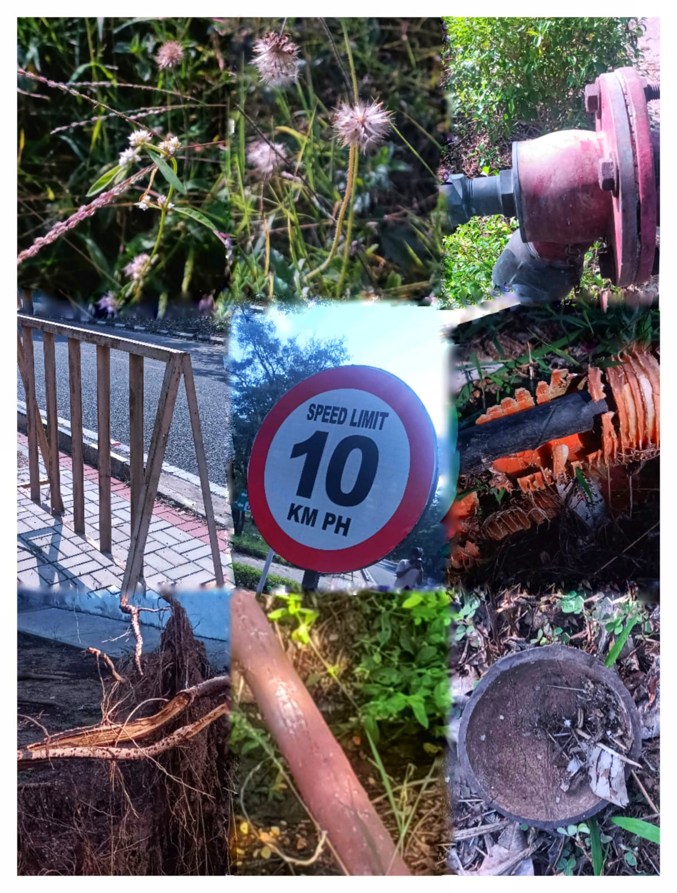
EC23I2010
K.VENKATA MANISH

Slide 20
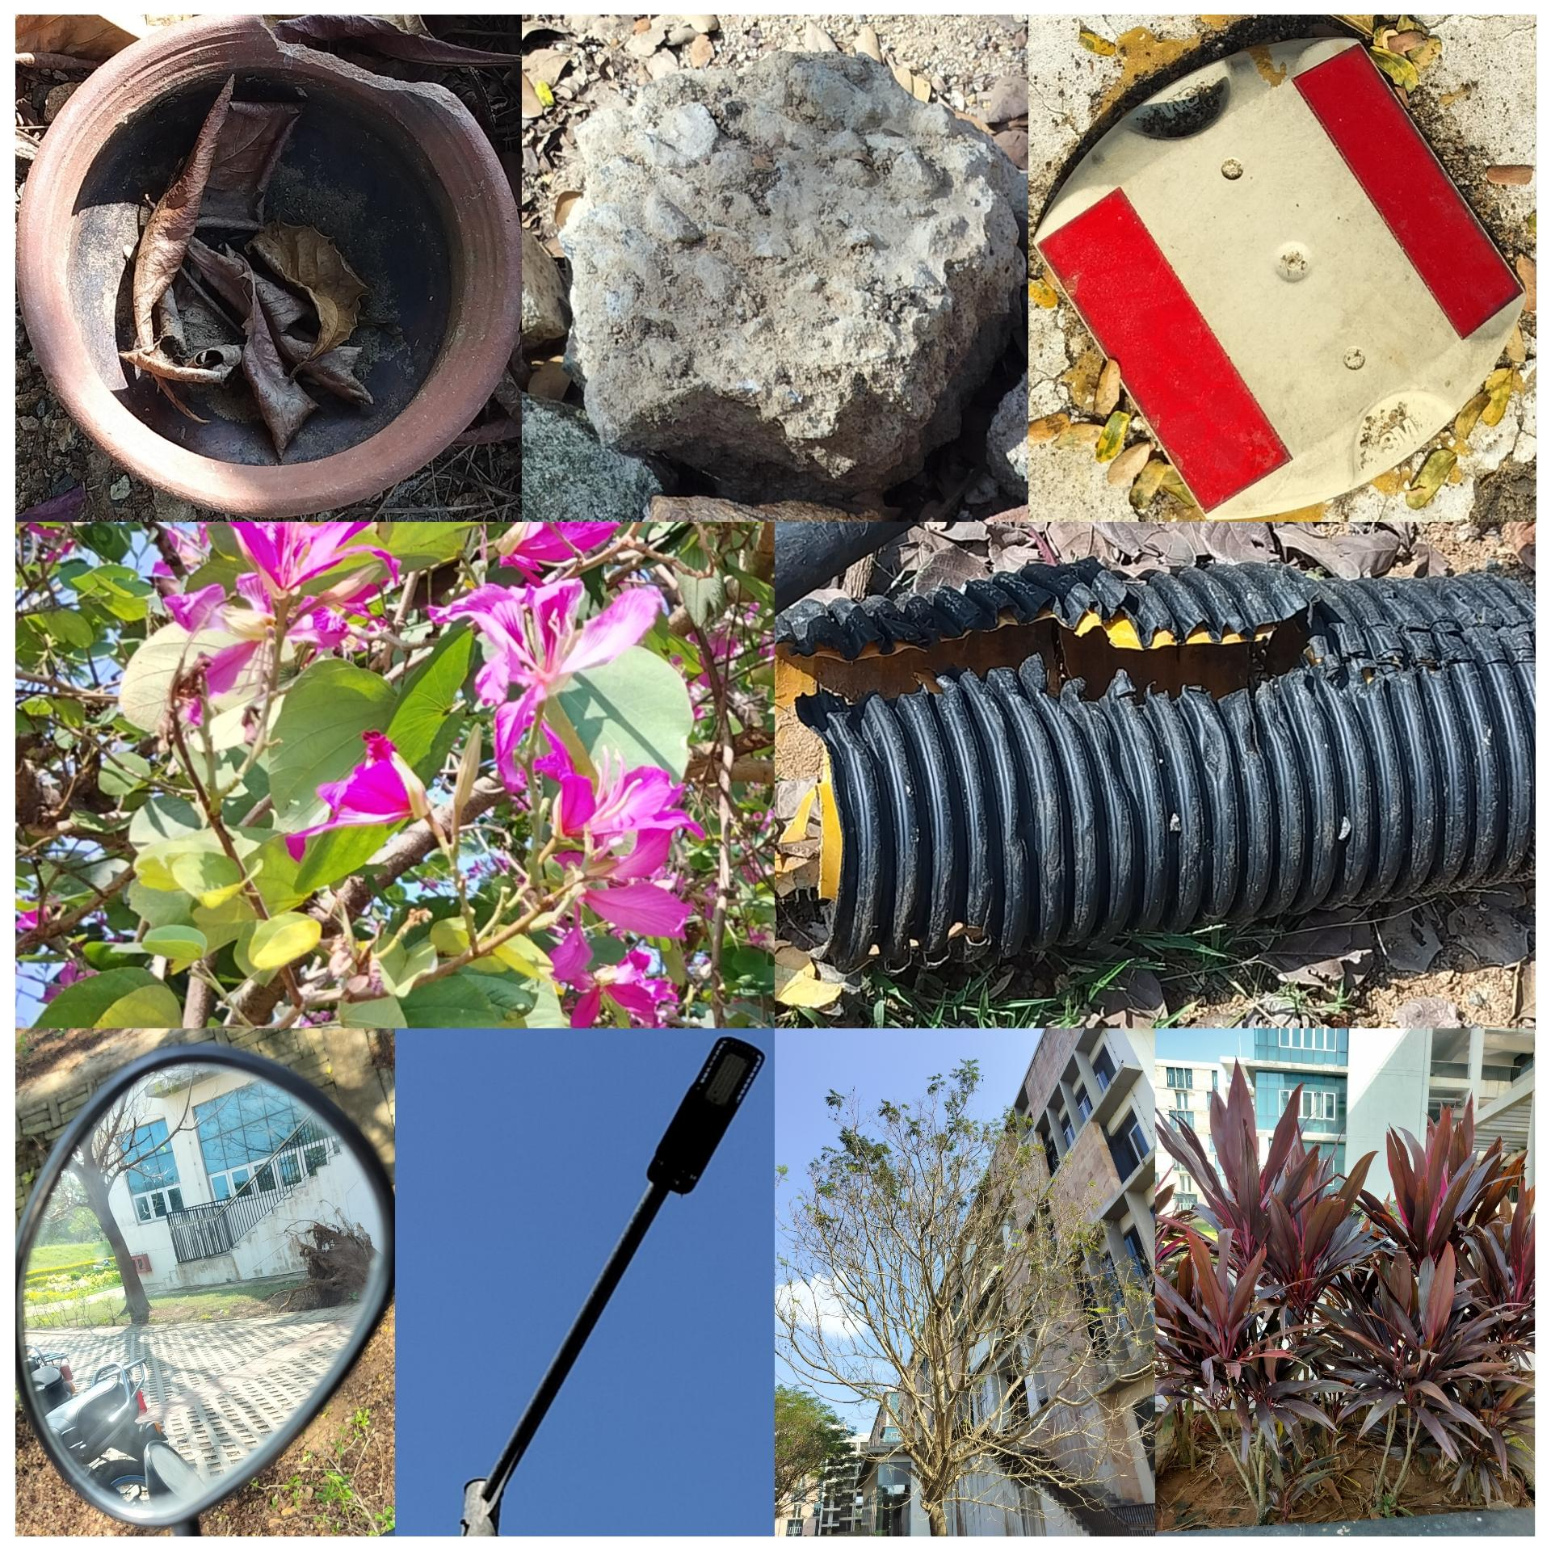
EC23B1120
RITHANYA S

Slide 21
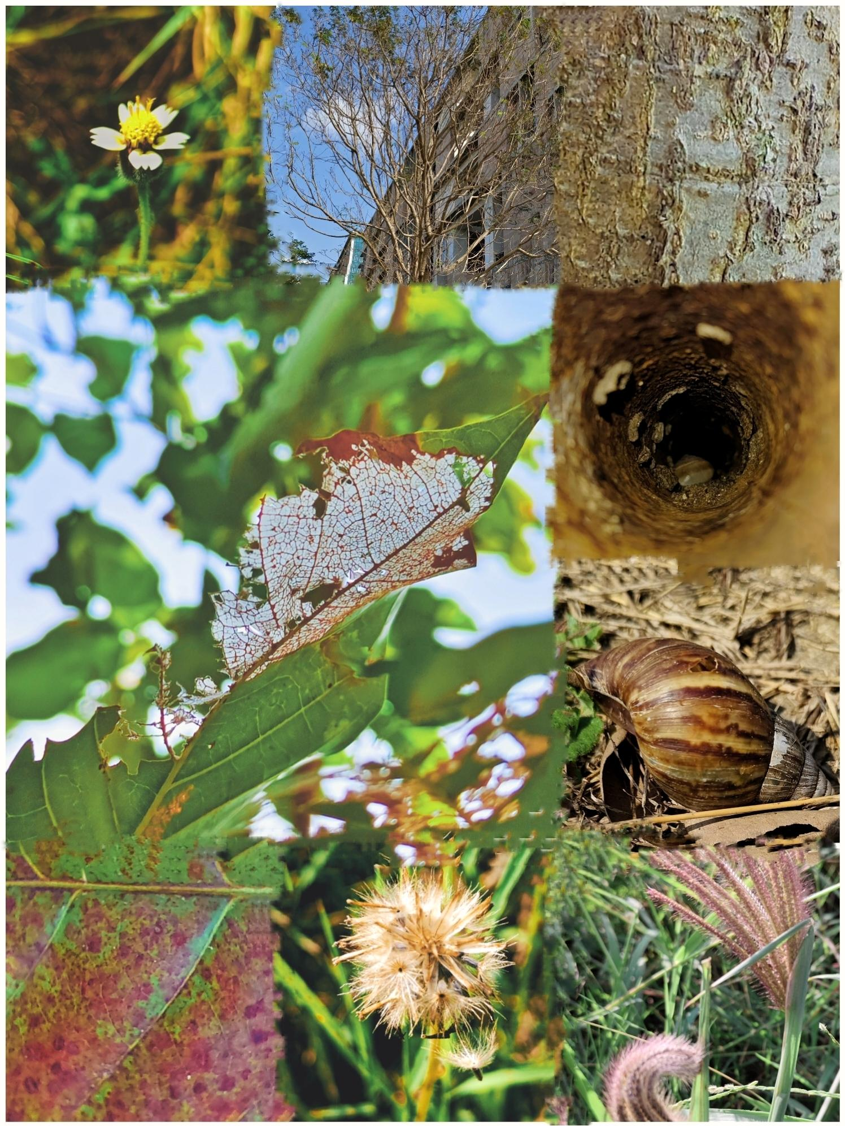
EC23B1127
M.SOMESHWAR RAJ
Notes:
EC23B1127
M.Someshwar Raj

Slide 22
THANK YOU
THANK YOU

